Slide 1
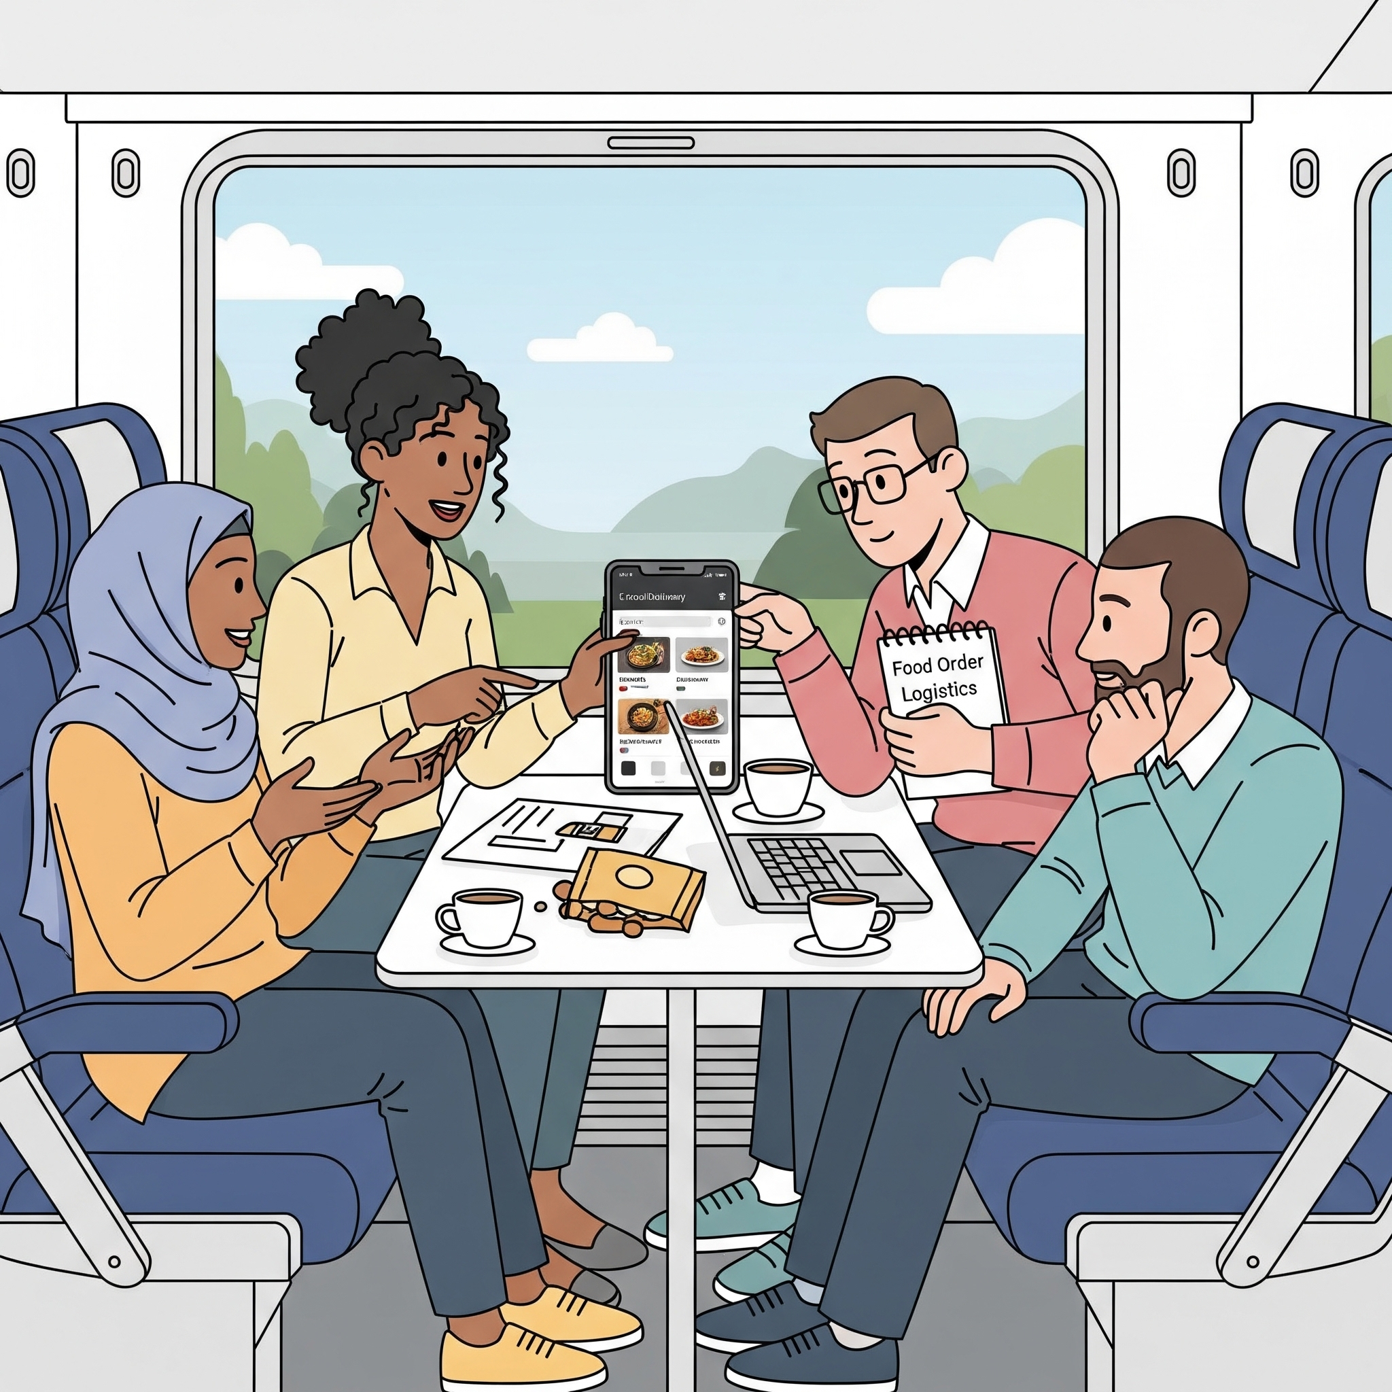
On-Train Food Ordering & Feedback System
Project Focus: Bridging the Logistical Gap in E-Catering
Team Members:
Sreya Datta Gupta (Semester VI)
Aditya Tiwari (Semester IV)
Prasun Biswas (Semester IV)
Institution:Adamas University

Slide 2
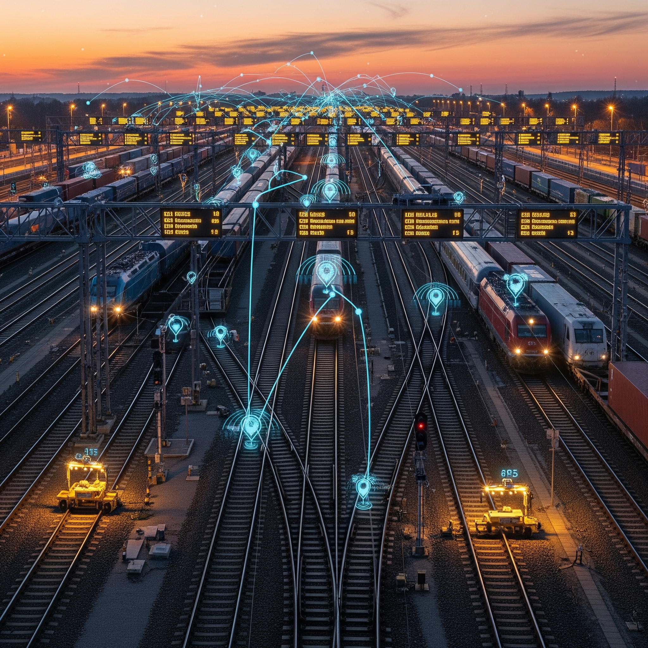
Introduction
Context: Indian Railways is the world's 4th largest network, but e-catering still struggles with "The Last Mile" synchronization.
Objective: To create a dynamic, GPS-synced ecosystem that ensures food quality, temperature, and delivery timing regardless of train delays.
Core Technology: Integration with NTES (National Train Enquiry System) API and a Serverless SaaS model.

Slide 3
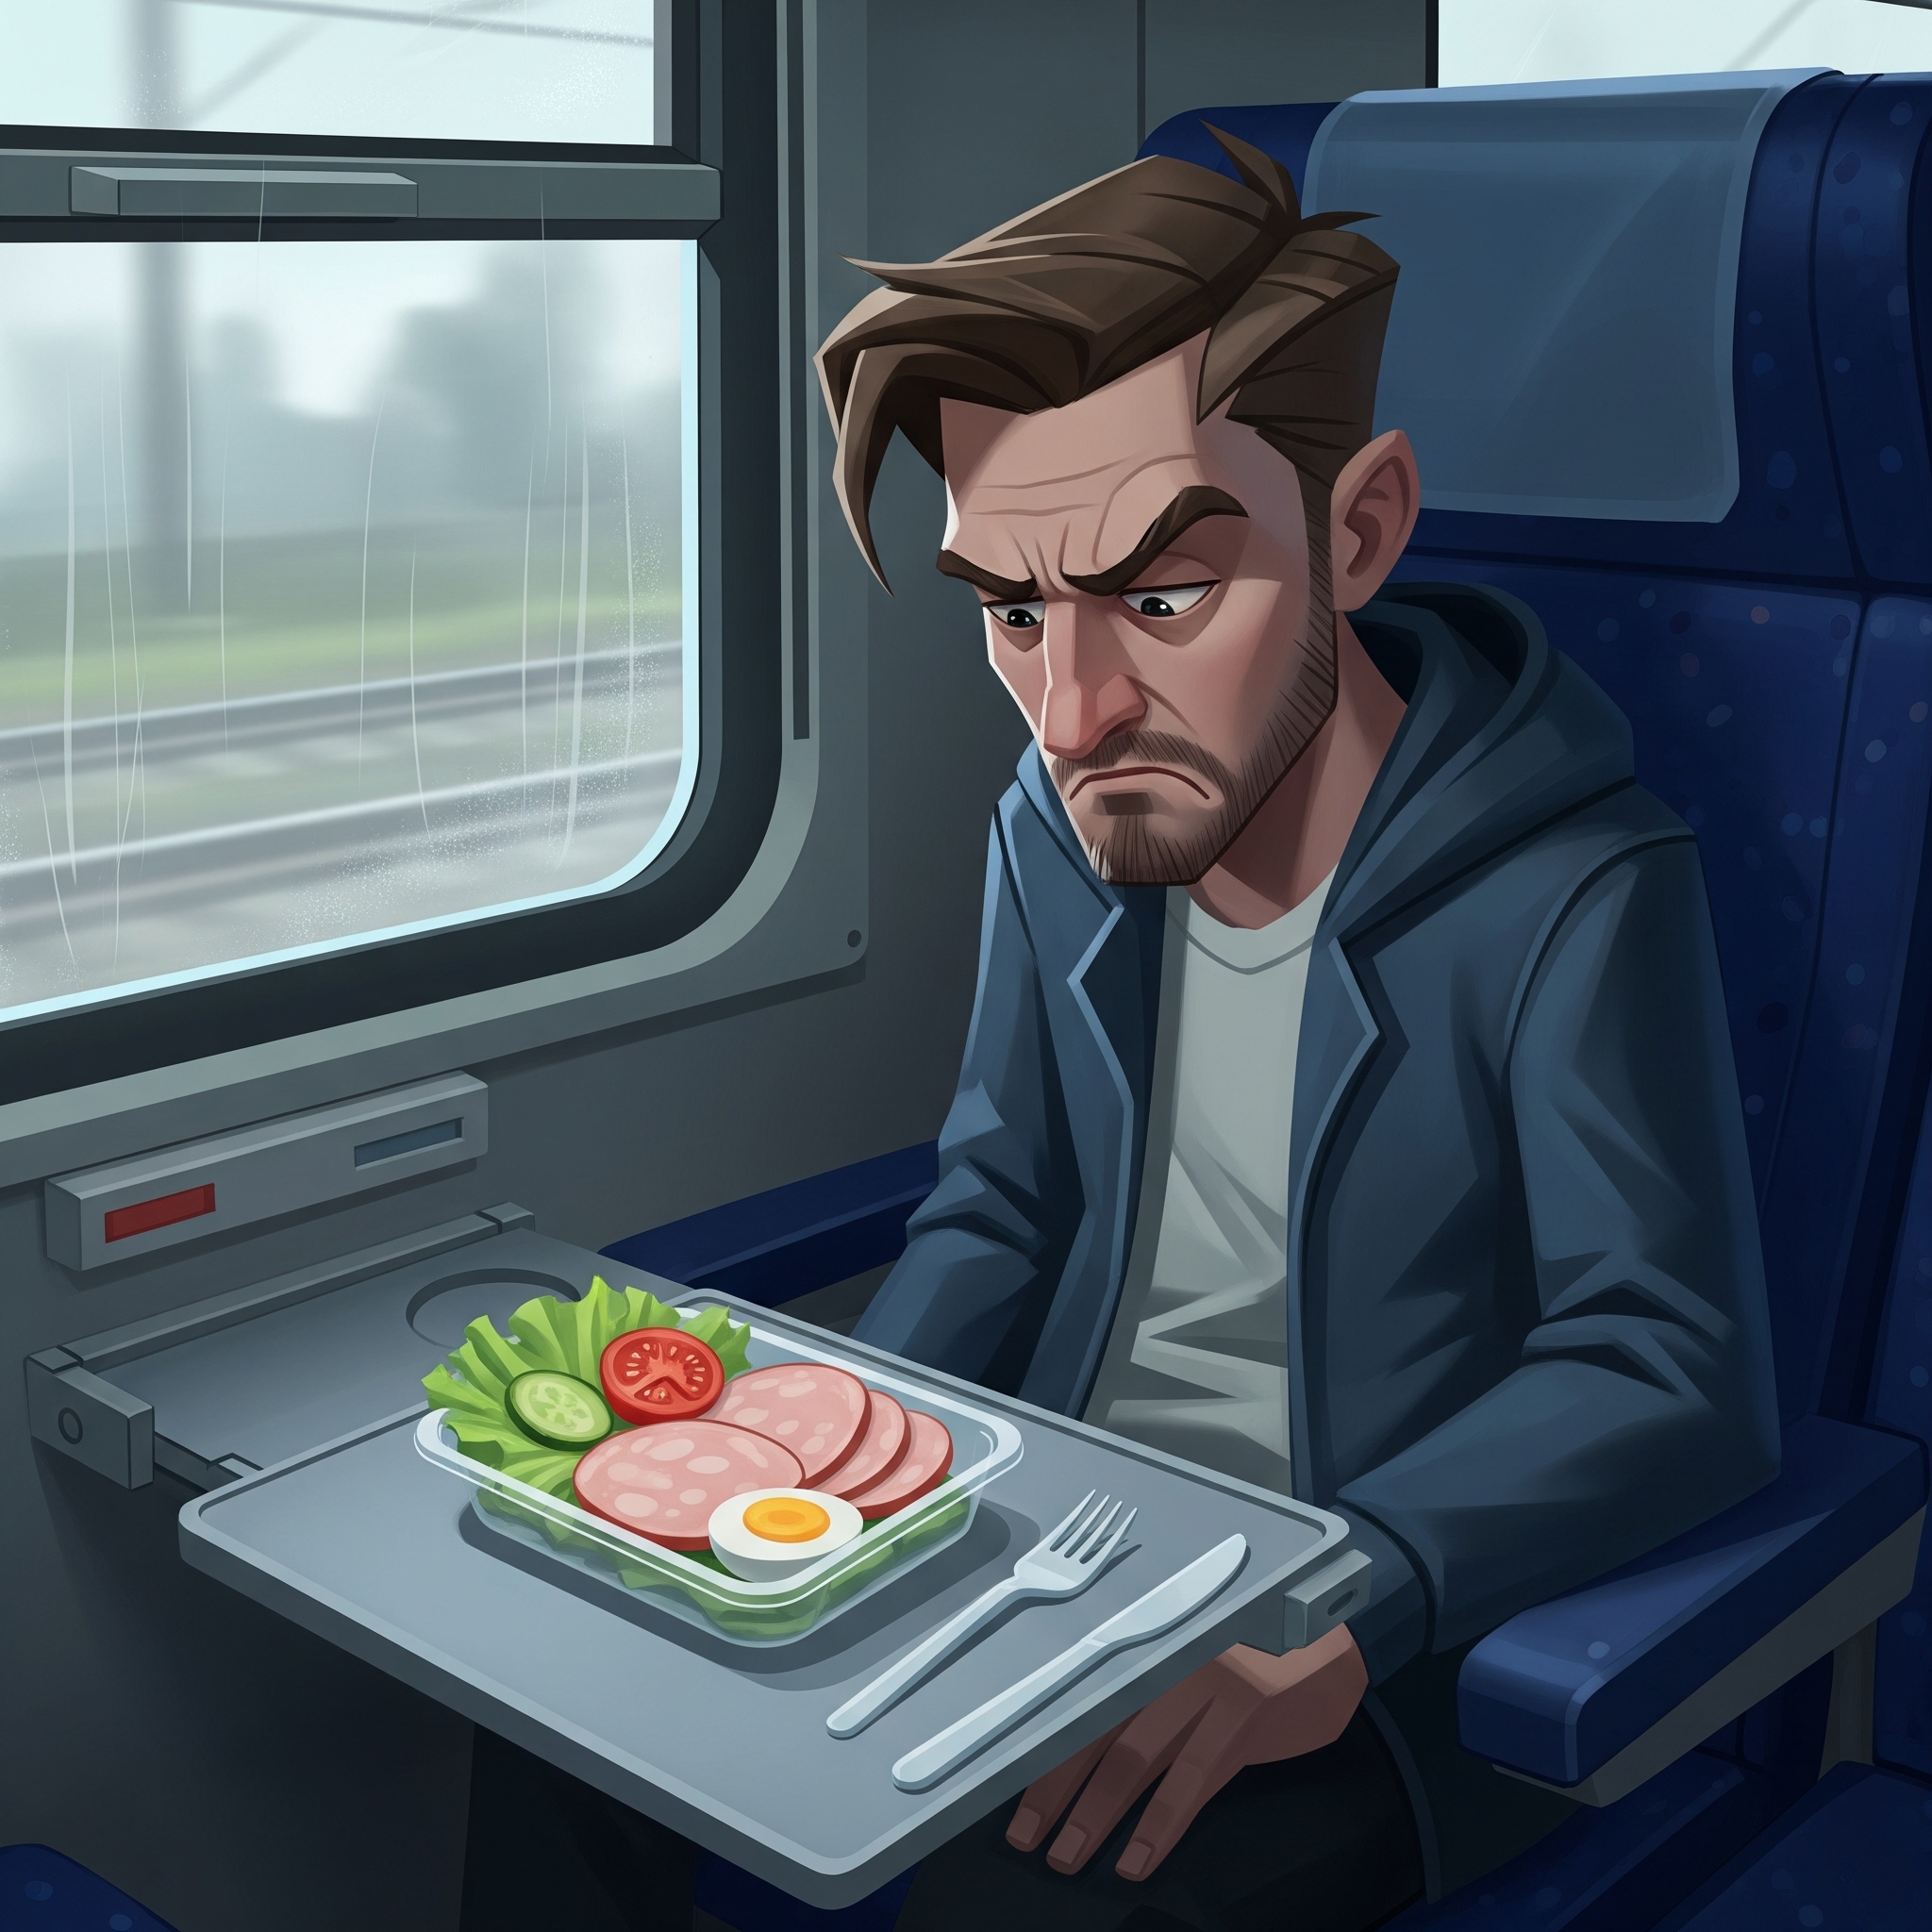
The "Moving Target" Dilemma
Trains are dynamic; food prep is static.
Information Asymmetry: No live tracking for the passenger.
Logistical Latency: Delays = Cold food or missed delivery.
Feedback Dead-ends: Quality issues are reported too late to be fixed.

Slide 4
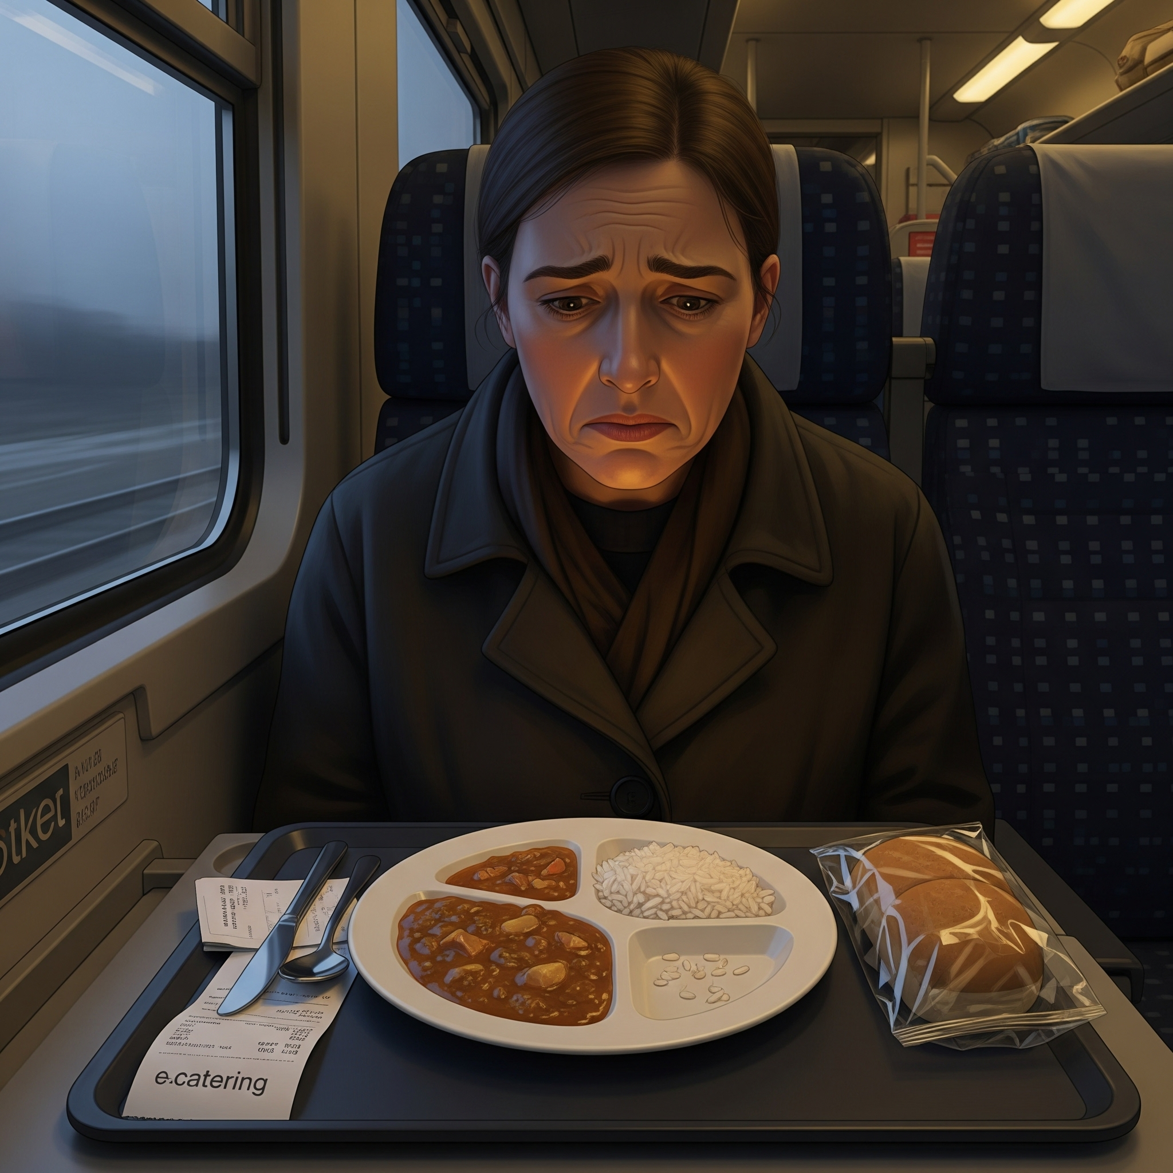
Survey of 5 People (The "Why")
Based on our user research, 80% of passengers cite 'Uncertainty' as the reason they avoid e-catering.
Passenger 1: Complained about food being "stone-cold" due to an outer-signal delay.
Passenger 2: Missed a delivery because they didn't know which end of the platform the agent was at.
Passenger 3: Worried about sharing personal phone numbers with local vendors.
Passenger 4: Wanted to see "live hygiene" before ordering.
Passenger 5: Frustrated by the 7-day refund cycle for failed deliveries.

Slide 5
As-Is vs. To-Be Process Map
Feature | AS-IN(CURRENT SITUATION) | TO-BE(PROPOSED)
Kitchen Trigger | Fixed Time(eg:60 mins before ETA ). | Dynamic:prep starts based on live Gps distance
Delay Sync | No automated link to kitchen. | Automated “Hold/Pivot” logic via NTES API
Tracking | Static SMS updates | Visul:Live Map showing the agent on the platform
Payment | Instant capture (refunds take 7 days) | Escrow:Funds Released only after OTP verification.

Slide 6

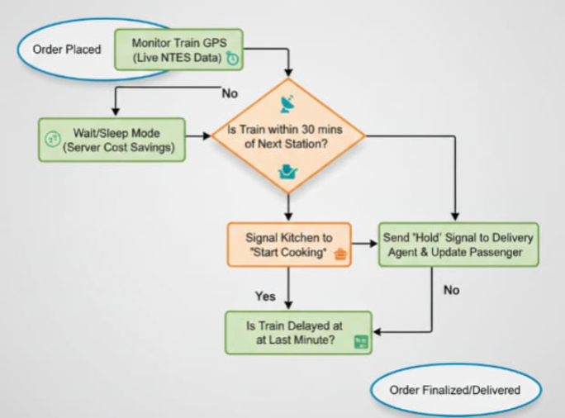
The Wait/Sleep Mode logic. By only pinging the GPS frequently when the train is within 30 minutes, we slash API costs by 60%.
Order placed
Monitor Train GPS (Live NTES Data
The Last-Minute Delay Pivot, which holds the delivery agent if the train hits a signal stop.

Slide 7
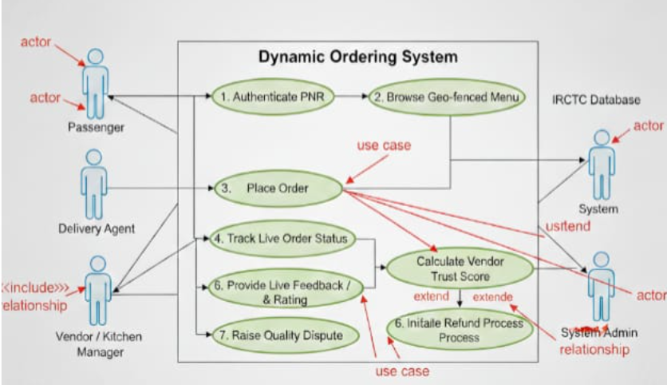
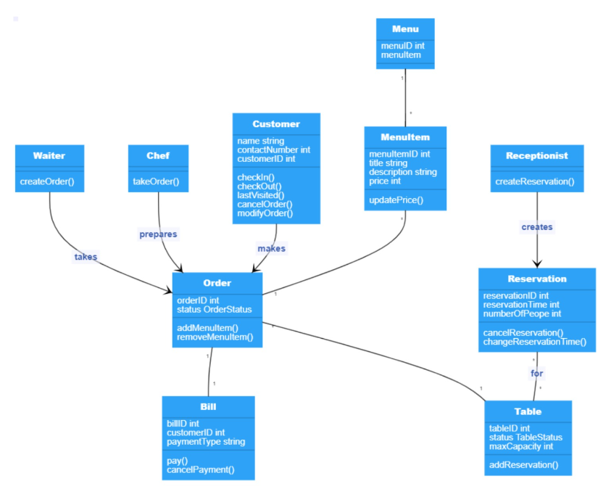
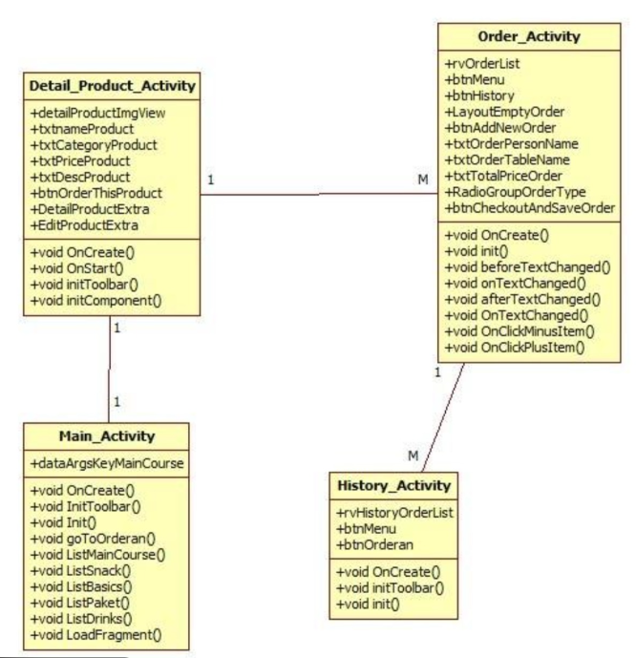
UML (Use Case Diagram & class diagram)
Key Logic: Place Order <<include>> Authenticate PNR.
Secondary Actor: IRCTC Database & NTES API.
Extended Logic: Raise Dispute <<extend>> Verify Delivery. You cannot complain about food you didn't receive!

Slide 8
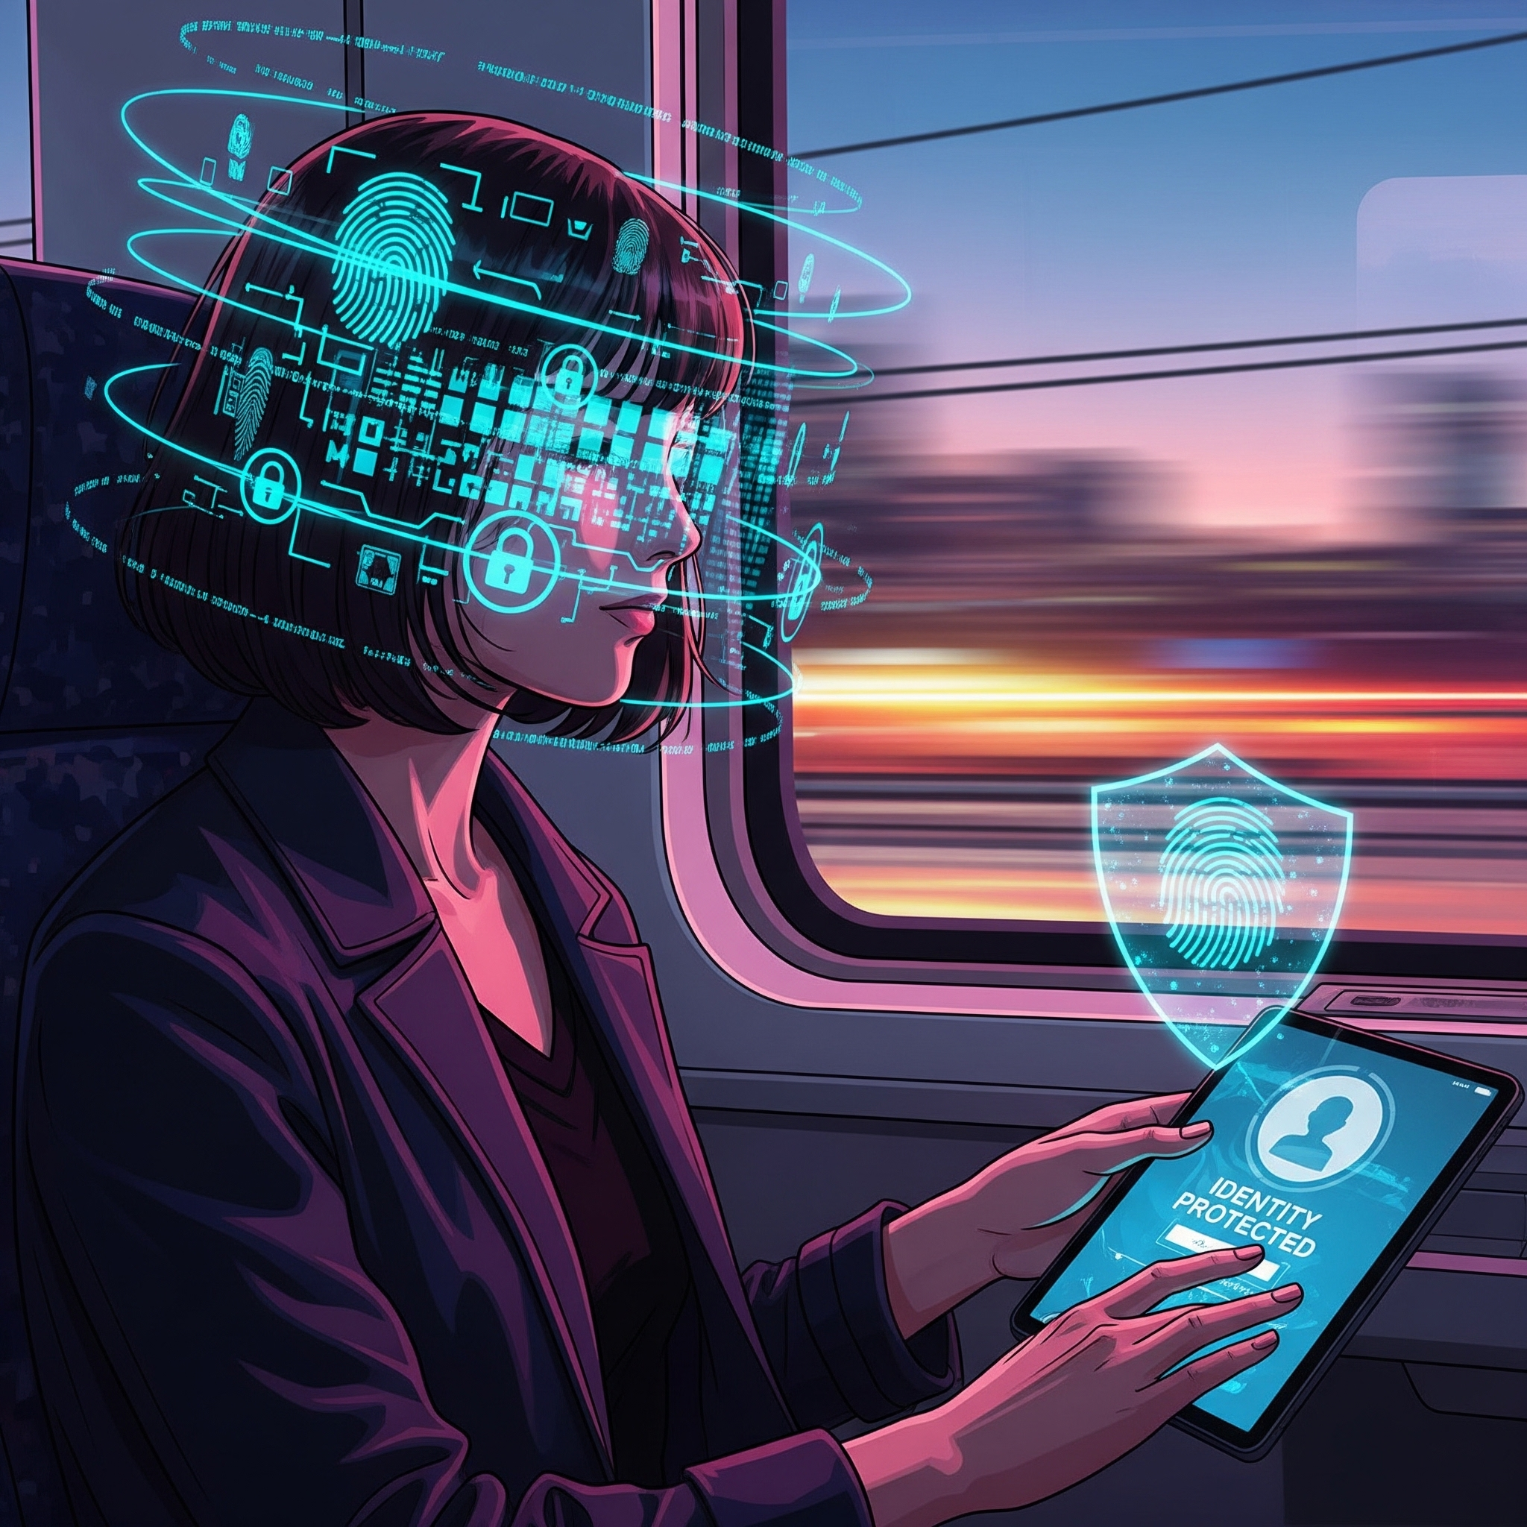
Security & Safety Measures
PNR Masking protects personal identity with a Transit Token
Vendors only receive Coach and Seat information for deliveries
Geo-Fenced OTP ensures agents are near the train for delivery success
Encrypted Audit Trails prevent vendors from tampering with hygiene ratings

Slide 9
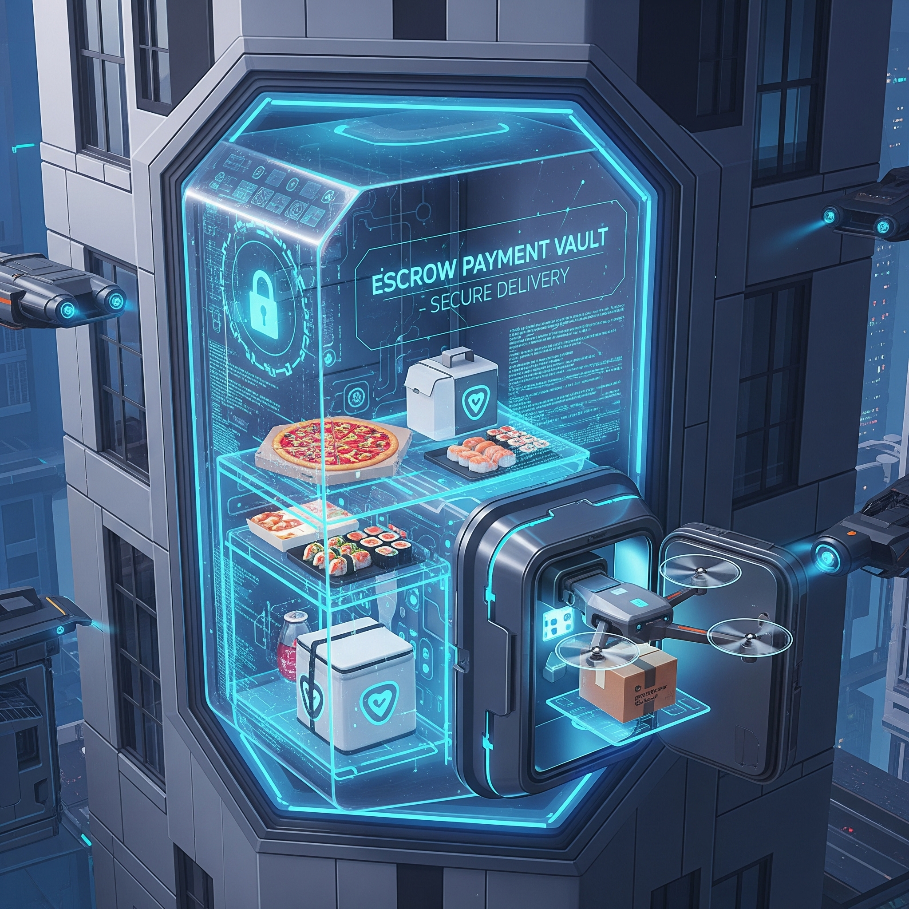
Smart Escrow: Payment Protection
Payment is held in a digital vault until delivery is verified.
A 15-minute window allows reporting stale or cold food post-delivery.
Payment is frozen for vendors when a quality dispute is raised.
Orders pivot to a new vendor if the train delay exceeds one hour.

Slide 10
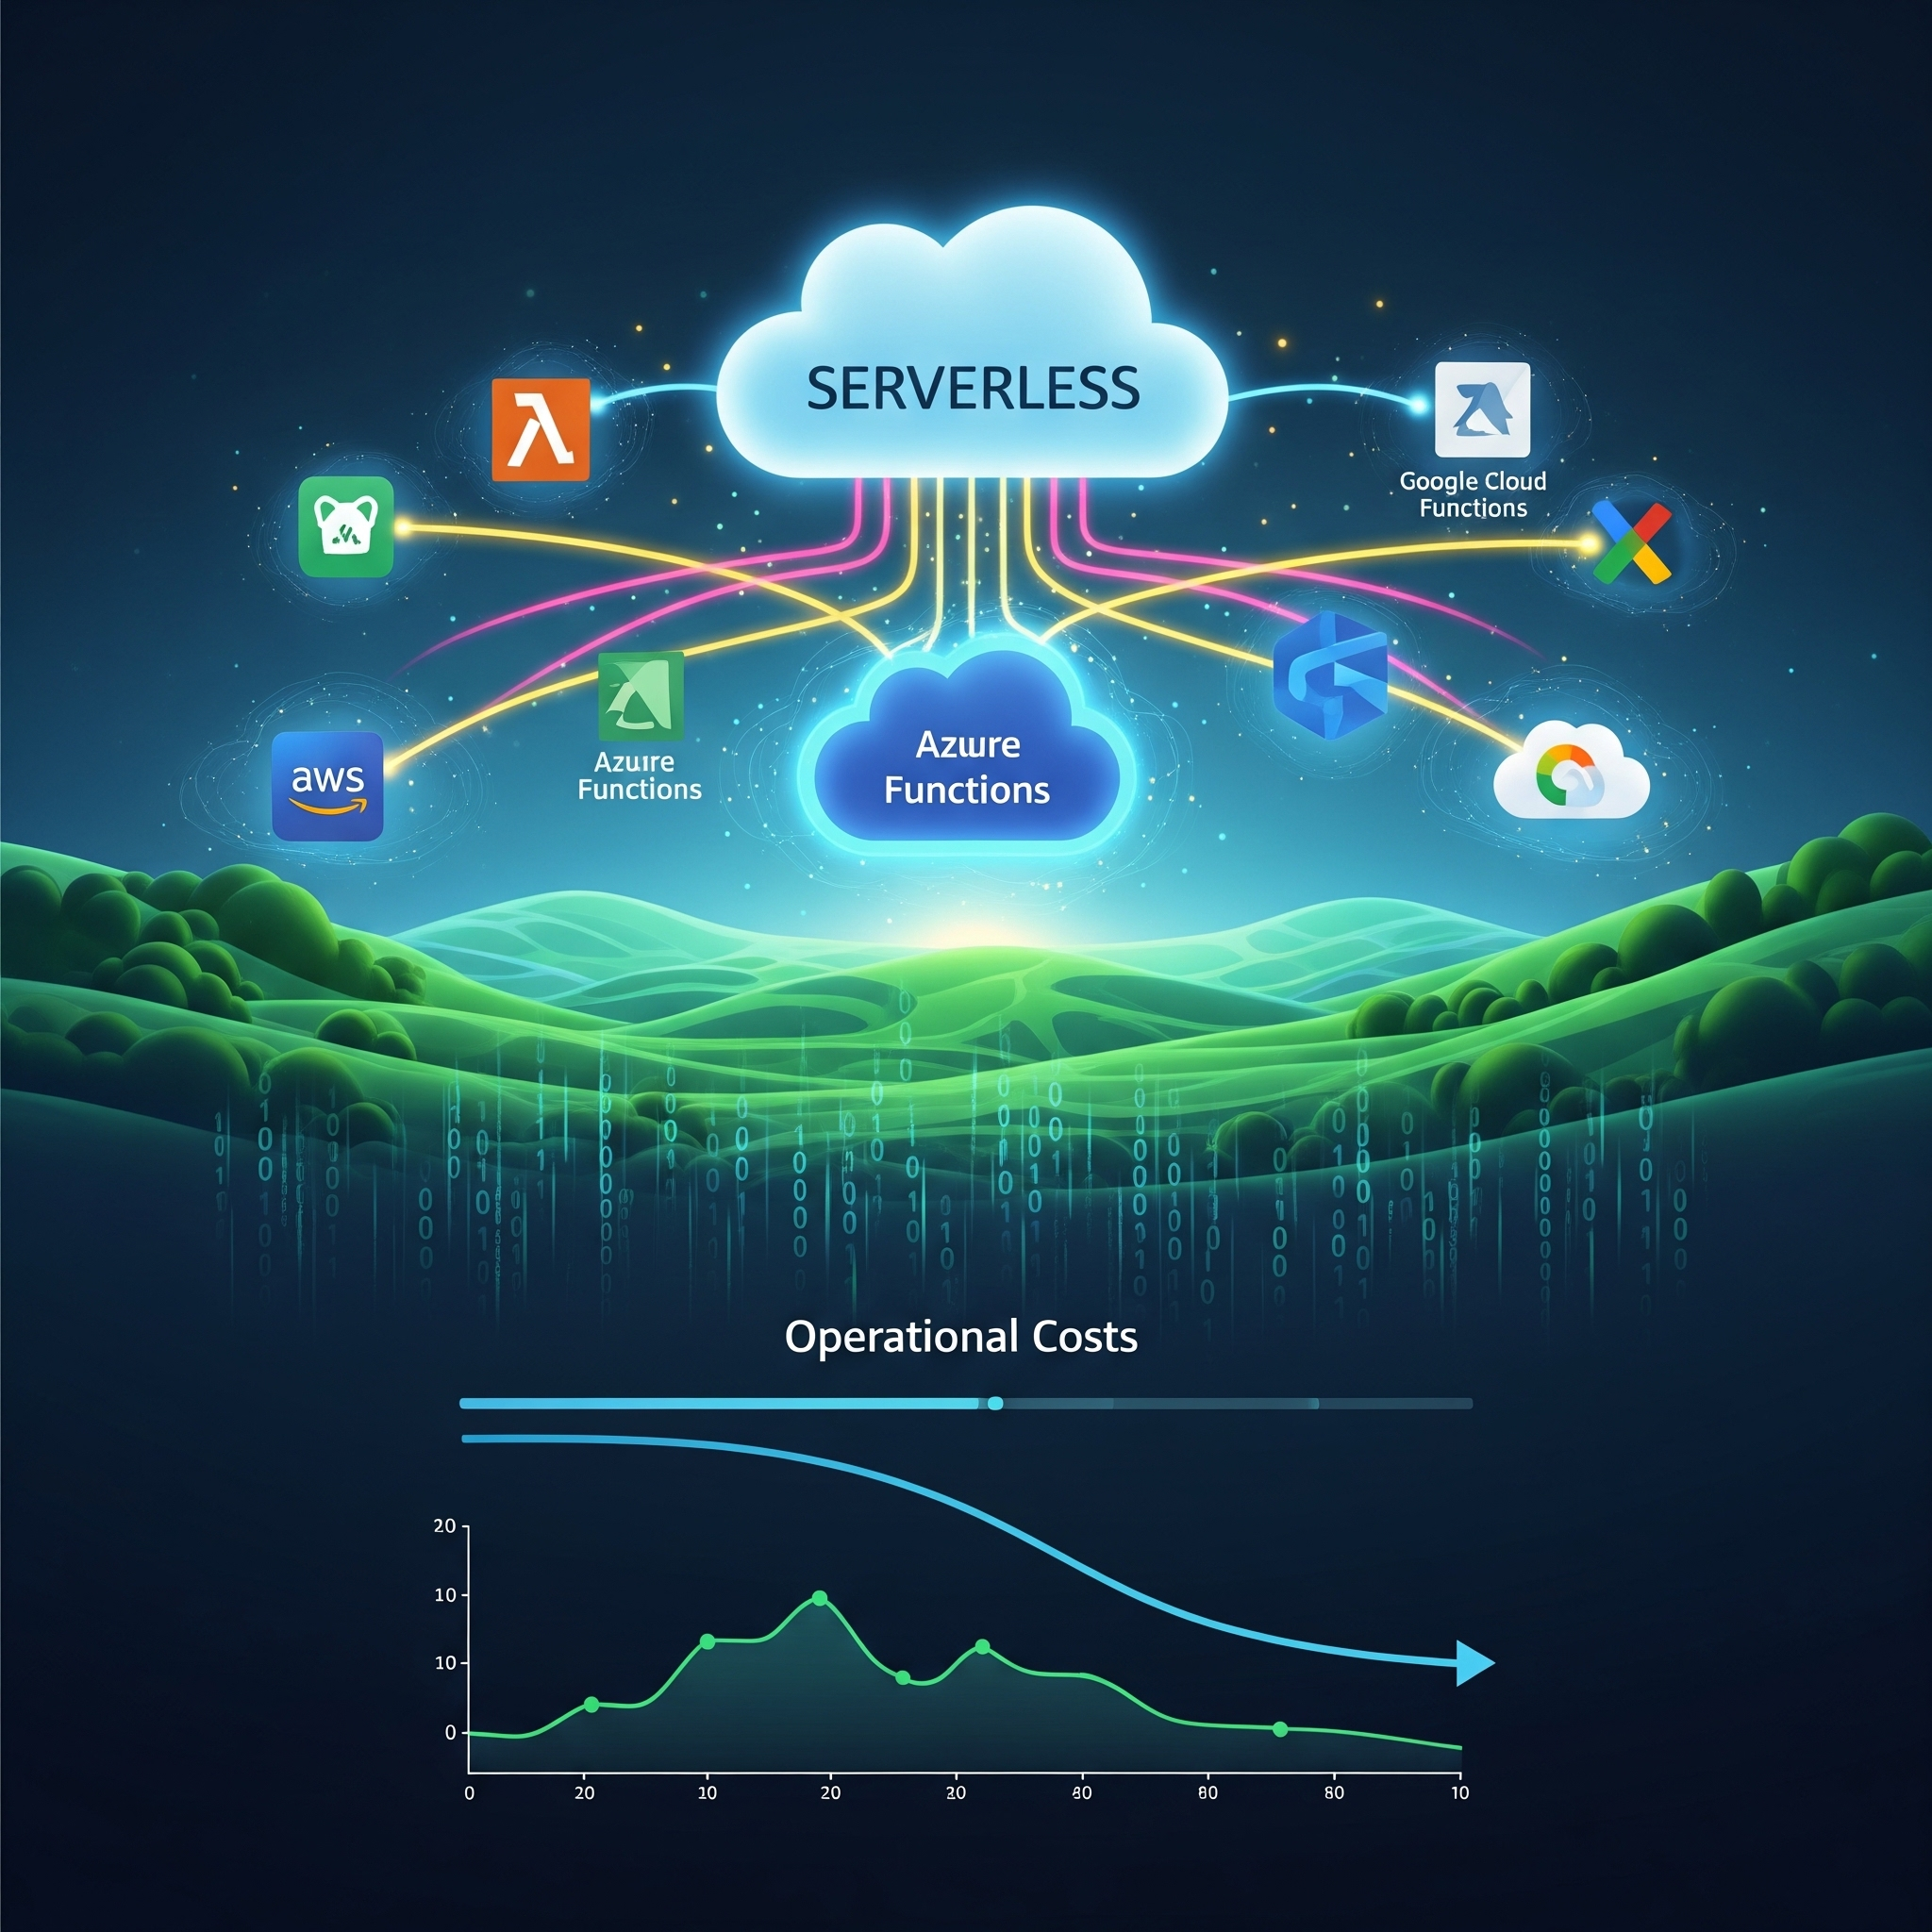
Budget Control & Scalability
The model avoids physical hardware, keeping the system asset-light.
Serverless architecture ensures operational costs are minimized per transaction.
A 5% "Trust Fee" per order effectively covers all necessary operational expenses.
No orders mean no operating costs, ensuring efficient budget control.

Slide 11
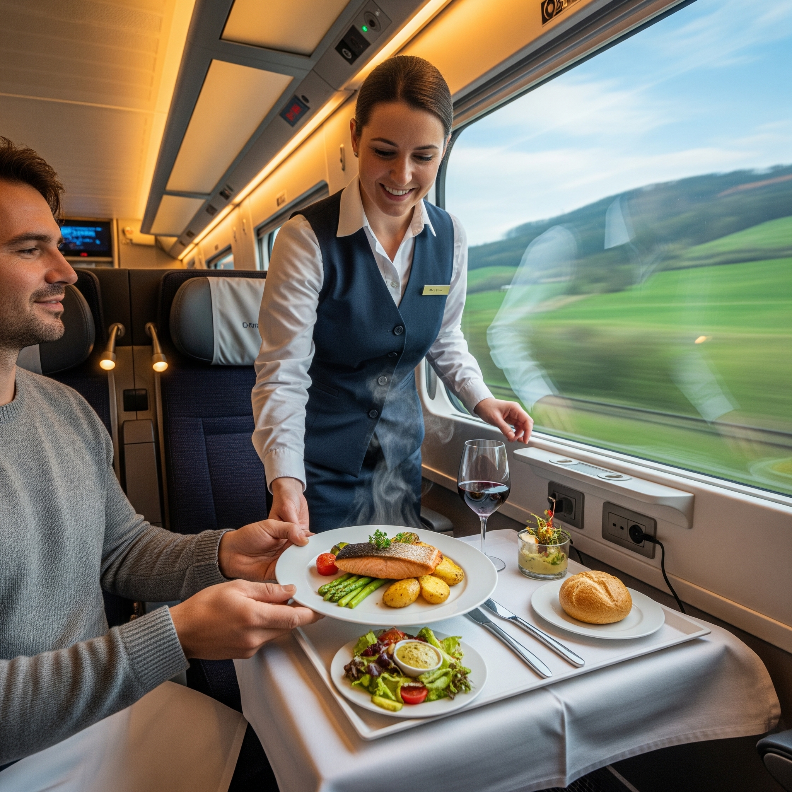
Observation and Conclusion
Observation: The bridge between GPS data and kitchen preparation is the single biggest factor in food quality.
Final Word: Our system turns a chaotic logistical nightmare into a predictable, high-quality service, ensuring the Indian Railway passenger is no longer "left hungry at the signal."

